Slide 1
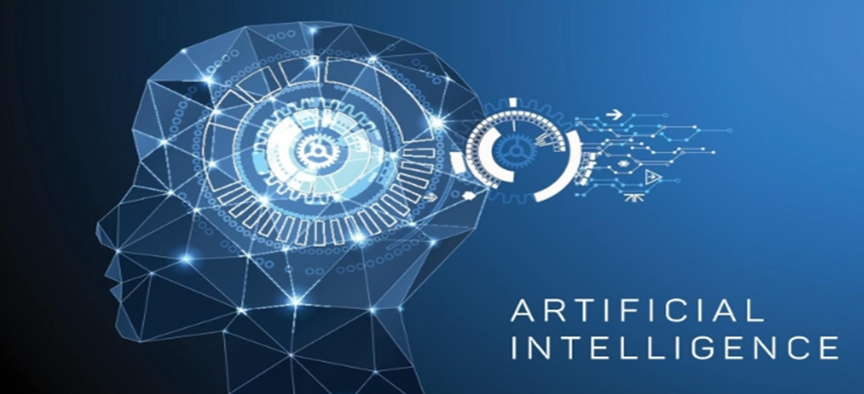

Slide 2
Generative models have long been used in statistics to study numbers. With recent advances, these models can now analyze more complex things like pictures and sounds. But before diving into generative technology, it helps to have a basic understanding of artificial intelligence (AI).
In this lesson, you’ll learn about AI, deep-learning models, and how these models can produce likely results when given a prompt.
AI, machine learning, and deep learning all work together to help systems not only understand but also create content and responses. Generative AI uses deep learning to make new things like images, text, and even conversations by recognizing patterns in existing data.
Machine Learning
Machine learning is a fast-growing field with many real-world uses, like voice assistants, recommendation systems, and self-driving cars

Slide 3
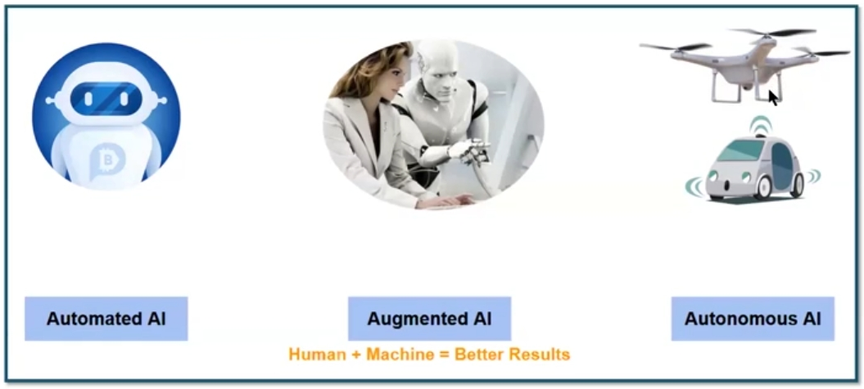

Slide 4
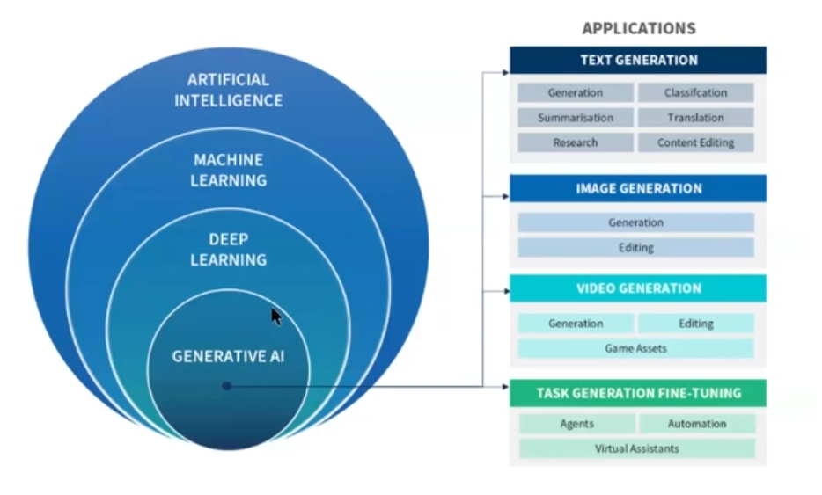

Slide 5
Types of machine learning
Supervised learning: Uses labelled examples to train the system to classify data or predict outcomes accurately.
Unsupervised learning: Lets the system figure out patterns in data that isn’t labelled, often with little to no human help.
Semi-supervised learning: Uses a mix of labelled and unlabelled data to train the system.
The type of machine learning used depends on the problem, how much labelled data is available, and the goal.

Slide 6
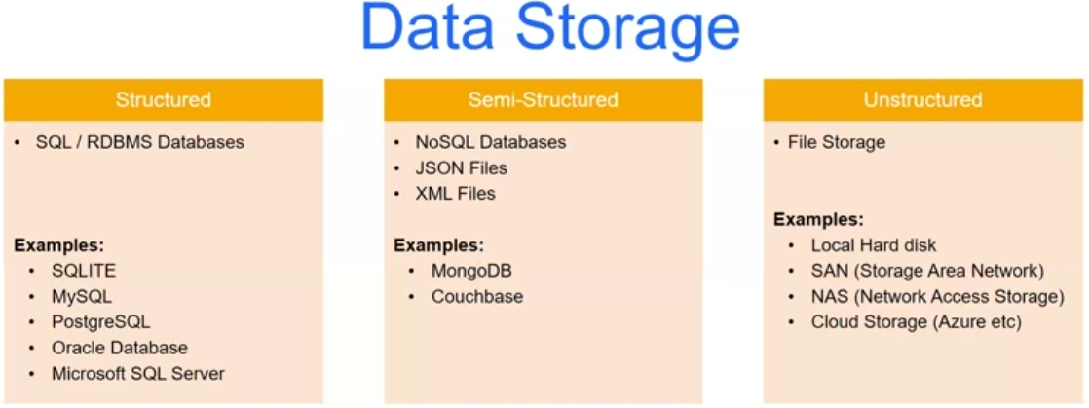

Slide 7
Deep Learning
Generative AI, part of deep learning, involves systems that take raw data and create new outputs that look similar to the original. Unlike traditional machine learning, which needs clean and labeled data, deep learning works with messy, unstructured data like text and images. It can identify important features on its own, making the process easier and requiring less work from human experts.
Generative AI
Generative models started in statistics to look at numbers, but deep learning allowed these models to handle more complex data like images and sounds. One of the early breakthroughs in this field came in 2013 with variational auto encoders (VAEs), which were among the first deep-learning models to generate realistic images and speech.
As we continue to learn more about this field, it’s important to understand that generative models are designed to create new content based on patterns in the data they’ve been trained on.
In the 1990s, systems inspired by the human brain, known as neural networks, became popular. Unlike earlier rule-based systems, these networks can learn from data in more flexible ways. This breakthrough led to advancements in technology, making it possible to create realistic and creative content using these brain-inspired systems.
Here’s a look at the key developments in this field:

Slide 8
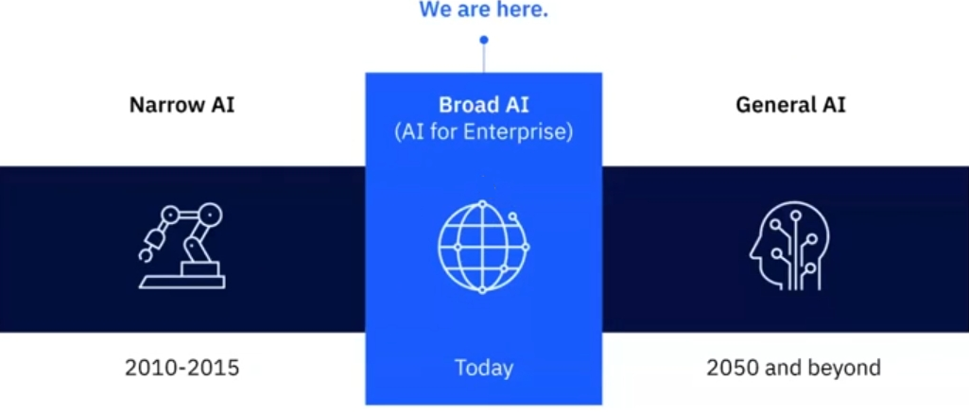
2022: ChatGPT
OpenAI launched ChatGPT in 2022, a chatbot that allows users to have customized conversations. It can generate, extend, and modify text to fit different styles and formats, thanks to powerful text-based models.
2023: IBM watsonx
IBM introduced watsonx.ai in 2023, a platform combining advanced content creation tools with traditional machine learning techniques, allowing people without coding experience to create and fine-tune models.

Slide 9
Large Language Models narrated in a simplified format
Large language models (LLMs) are advanced programs designed to process and create text. What makes these models interesting is that they analyze massive amounts of text and use this knowledge to generate new content that mimics the style and tone of the original material. Examples of LLMs include OpenAI's GPT-4, Google's PaLM, and Meta's LLaMA.
There are two types of LLMs:
Proprietary Models: These are owned by a company or organization and can only be used by those who have a license.
Open-Source Models: These are freely available to the public under open-source licenses.
LLMs are related to foundation models, which are systems trained on large datasets and can be fine-tuned for specific tasks. In this section, we'll explore how large language models work, how they are connected to foundation models, and how they can help solve different business problems.
Responsible use of Large Language Models
To make sure LLMs are used responsibly, ongoing research, ethical guidelines, and cooperation within the industry are crucial. The aim is to create standards for using these models in ways that benefit society without causing harm.
Tokens and tokenization
When using large language models, a process called tokenization is important. Tokenization breaks text into smaller units called "tokens," which can be individual characters, words, or even parts of words. This step helps LLMs understand the text and perform tasks like classifying text or analysing emotions. For example, in technical fields, tokenization might break down complex terms to make them easier to process.
LLMs have token limits, which refer to the maximum number of tokens they can handle in one go. For example, if a model has a token limit of 2500, it will only process that number of tokens. If you want to generate a long document, the token limit will restrict how much text can be created at once.

Slide 10
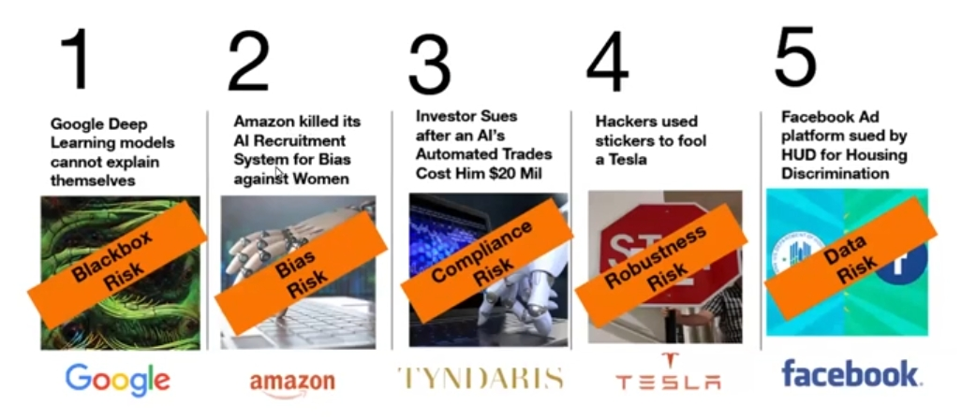

Slide 11
Here's an example of how tokenization works: Consider the sentence:
"Tomatoes are one of the most popular plants for vegetable gardens."
Some words, like "tomatoes" and "pests," might be broken into multiple tokens, while others remain whole. Each model has its own method of breaking down text, and it's important to use the same method that was used when the model was trained. This ensures that the model can understand and process the input correctly.
Simplified explanation of tokenization algorithms
Before certain programs that generate text can work properly, they need to be trained to break down words into smaller parts. This process is called tokenization. Tokenizing helps the program understand words it hasn’t seen before and improves its overall performance.
Types of tokenization algorithms
Byte Pair Encoding (BPE)
This method creates a list of word parts based on how often they appear in the training data. It’s commonly used in programs that handle text, like GPT-2.
Example:
For the word "chatbot", BPE might split it into smaller parts like this:
('c', 'h')
('cha', 't')
('chat', 'b')
('chatb', 'o')
In the end, the list might include: {'c', 'h', 'cha', 't', 'chat', 'b', 'o’}.

Slide 12

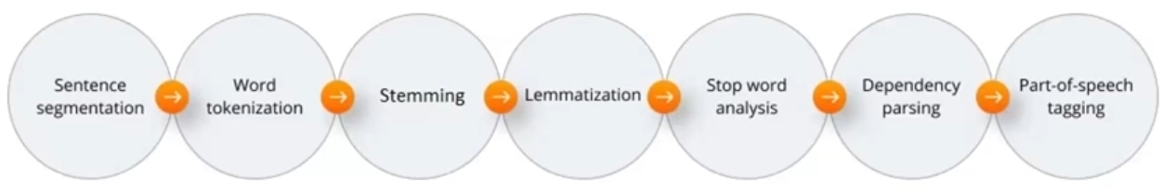

Slide 13
WordPiece
This method starts with individual characters and then gradually merges them based on how often they appear together. This is used in models like BERT.
Example:
Starting with the characters: 'c', 'h', 'a', 't', 'b', 'o', WordPiece might group them as:
'cha', 't', 'b', 'o'
'chat', 'b', 'o'
The final list could be: {'c', 'h', 'a', 't', 'b', 'o', 'cha', 'chat’}.
SentencePiece
This newer method treats the input text as a series of sentences and breaks it down into pieces. It is used in models like T5, which handle a variety of text-based tasks.
How tokenization works
Tokenization can break down words into smaller units and mark them with symbols like "##" to show they are part of a larger word. This helps the program understand uncommon words better and improves its accuracy.
The goal is to represent the vocabulary of a language in a way that simplifies the text, making it easier for programs to process, understand, and create new text. The choice of tokenization method depends on the specific program and the task it’s designed to handle.
Now that you know a bit about tokenization, it's essential to understand why breaking text down this way is a critical first step in training text-based programs. However, challenges may arise during this process, such as dealing with punctuation, special characters, or unique languages.

Slide 14
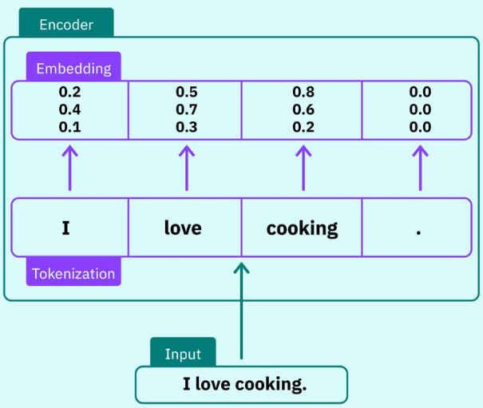
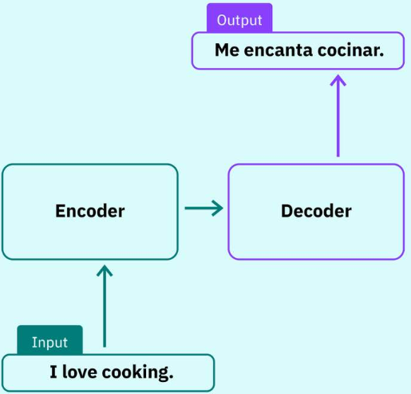

Slide 15
Embedding: Representing words with numbers
When dealing with text, programs use something called embeddings to turn words into numbers. For example, if you have words like "flower," "plant," and "sprout," embeddings create a numerical representation of each word. These numbers allow programs to understand the relationships between words and their meanings.
When the program processes these numbers, it can perform different tasks, like classifying words or generating sentences. A mathematical function called Softmax helps turn these numbers into probabilities, which the program can then use to determine which category or option is most likely to be correct.
By converting words into numbers, programs can better understand language and perform calculations that help them analyze and generate text.
Simplified Explanation of Embeddings without technical jargon
Let’s explore how a program that generates text can use numerical data to understand words. Consider a table that compares different words like "flower," "plant," and "sprout" based on various features, or characteristics, like size, water needs, and color. Each feature is given a value between 0 and 1, where 0 might represent a smaller size or less water requirement, and 1 could indicate something larger or needing more water.
For instance:
Size measures how big or small the object is.
Water requirement shows how much water is needed.
Colour reflects the typical colour intensity.
Now, if we add words like "eat," "wood," and "vegetable" to this comparison, we can map each word’s characteristics onto a graph. On this graph:
The x-axis could represent the size of the object.
The y-axis could show the water needs.
The z-axis could illustrate the colour intensity.
By plotting these words on the graph, we can visually see how closely related they are based on their features. Words like "flower," "plant," "sprout," and "vegetable" might appear close together, suggesting that they have similar meanings or are commonly used in the same context.

Slide 16
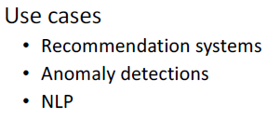
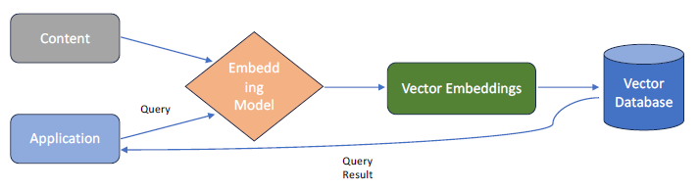
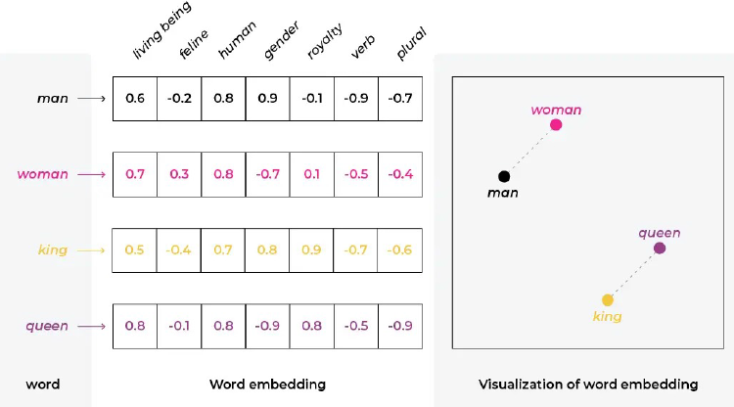

Slide 17
These numerical representations of words are called embeddings. They help the program understand how words are related to each other. Words with similar meanings have similar embeddings, which makes it easier for the program to process and generate text.
Embedding Models
Some well-known models that use embeddings include:
Word2Vec: This model turns words into numbers based on their meanings. Words that have similar meanings end up with similar numbers.
GloVe: Similar to Word2Vec, it focuses on how often words appear together to understand their meanings.
Embeddings are not just for words; they can also be used for sentences, images, and even whole documents:
Sentence Embeddings: Programs like InferSent and Universal Sentence Encoder (USE) create embeddings for entire sentences, allowing the program to understand the meaning of longer pieces of text.
Image Embeddings: For pictures, embeddings help programs compare and analyze images based on their visual features.
Document Embeddings: Tools like Doc2Vec create embeddings for entire documents, which helps in comparing long pieces of text based on their meaning.
Transformers: A new way to process text
Now that we have a basic understanding of how programs handle words using embeddings, let’s dive into a revolutionary method called Transformers. Introduced in 2017, transformers transformed the way programs handle language tasks. Before transformers, older methods (like RNNs and CNNs) were used but were less efficient.
Transformers don’t process information step by step. Instead, they can look at the entire text at once, allowing them to better understand and predict words based on their context. This is why modern text programs are able to create more human-like responses.
Rewritten with simplified terms:
RNNs (Recurrent Neural Networks) are often used to process language and recognize speech, while CNNs (Convolutional Neural Networks) are more commonly used to classify images and handle tasks related to visuals.

Slide 18
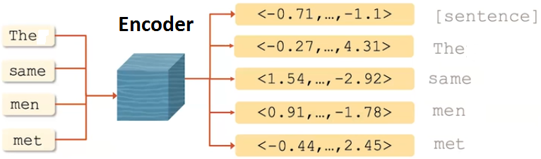
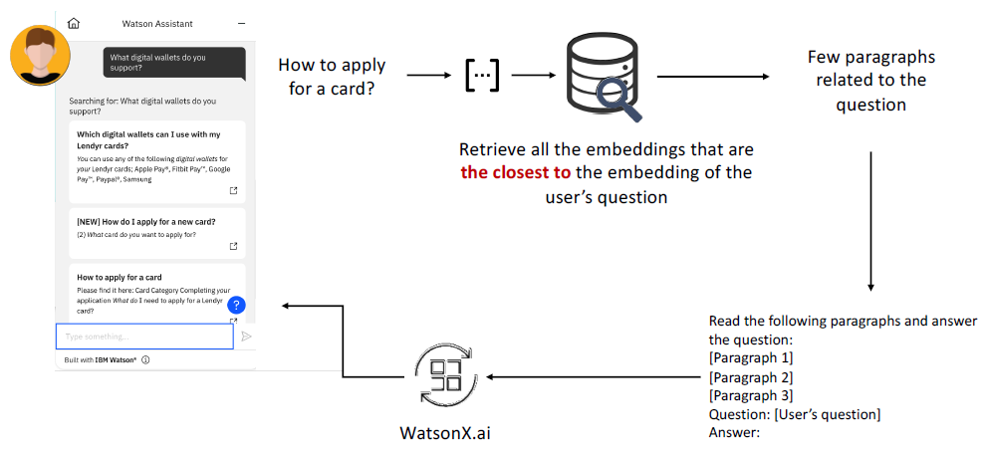

Slide 19
The transformer, a more modern technique, uses a method called "self-attention." Self-attention allows the program to focus on the importance of each word in a sentence while processing it. This is different from RNNs, which process information in a sequence, one step at a time. By using self-attention, transformers can understand the relationships between words better and can pick up on patterns that are farther apart in a sentence, making them very useful for understanding language.
A transformer has two key parts: the encoder and the decoder. The encoder takes in the input (such as a sentence) and transforms it into a meaningful representation. The decoder then uses that representation to generate an output (such as another sentence). After training on a large amount of text, the encoder learns how to capture important patterns in the input, while the decoder learns to produce accurate and grammatically correct responses.
Encoder-Decoder Example:
Imagine you’re part of a cooking team preparing a complex dish. The encoders are like the chefs who prepare the ingredients—chopping, seasoning, and marinating, which is similar to how the encoder processes words and turns them into meaningful components. The decoder is like the head chef, who assembles the dish, tasting and adjusting as needed. The decoder focuses on the prepared ingredients (the words) and puts them together to create the final meal (the output text). The cooperation between the encoder and decoder is key to making the final dish (or sentence) delicious and well-constructed.
Encoder
The encoder takes a sequence of words (such as "I love books") and breaks it down to understand the relationships between the words. It uses self-attention to figure out which words are important and how they relate to each other. For example, it will learn that "love" connects "I" and "books." The encoder does this multiple times, each time looking at the sentence in different ways to capture different aspects of meaning.
After understanding these relationships, the encoder applies another layer of processing, making the information even clearer. The result is a highly detailed understanding of the input, which the decoder can then use to generate an appropriate output.Decoder
The decoder starts with a special "start" signal and generates the output one word at a time. It uses the information from the encoder to make sure the output is relevant to the input. It also uses a rule that prevents it from looking at future words in the sequence it is generating. This ensures that it only considers previous words while deciding what word to generate next.

Slide 20
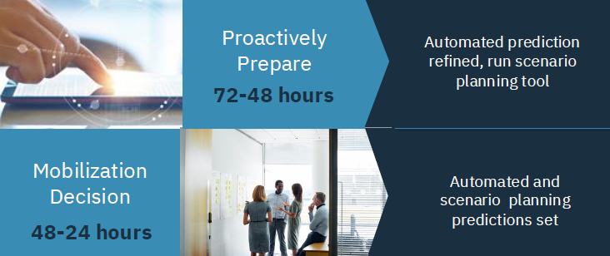
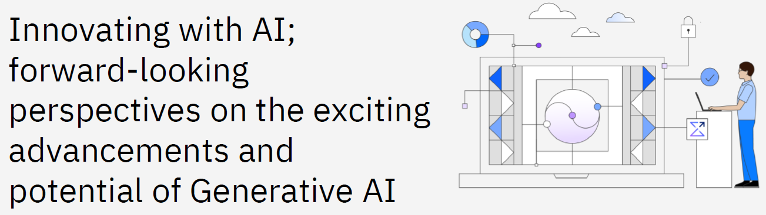
The time for widespread business adoption of generative AI has come. As company leaders race to fulfil AI’s potential to improve productivity and boost innovation, they are shifting from experimenting with AI to deploying and infusing it across their businesses. At the forefront of this shift are efforts to reinvent customer service, modernize countless lines of code, and automate workflows. But success demands more than identifying the right use cases; it depends on having an open and trusted technology architecture,built on a hybrid-by-design cloud infrastructure, that scales the secure and compliant use of AI models across multiple IT environments. Understand why the right combination of breakthrough technologies and expertise is the key to creating unique business value from AI today.

Slide 21
In addition to focusing on the previous words it has generated, the decoder also uses information from the encoder to make sure the generated text aligns with the input. Like the encoder, the decoder applies extra layers of processing to refine the output further.
This collaboration between encoder and decoder allows the transformer to handle complex language tasks, like translating languages or summarizing text, in a way that is efficient and highly accurate.
Here’s a simplified version of your statement, replacing technical terms:
The way the encoder and decoder interact is designed to help the system understand and connect the parts of the input (like words or sentences) with the output (such as a response). By using special mechanisms to focus on important parts of the input, this system is better at capturing these connections compared to older methods.
In this type of model, the encoder and decoder work together to process and produce things like text or speech. Here’s a brief explanation of how they function: The encoder and decoder both use focusing techniques and simple networks to handle the data. This allows the system to grasp complex relationships between the parts of the input and output, helping it produce results that are relevant and of high quality.
Risks and ethical concerns
Now that you’ve learned about how these powerful systems work, it’s important to recognize that, like any technology, they come with risks.

Slide 22
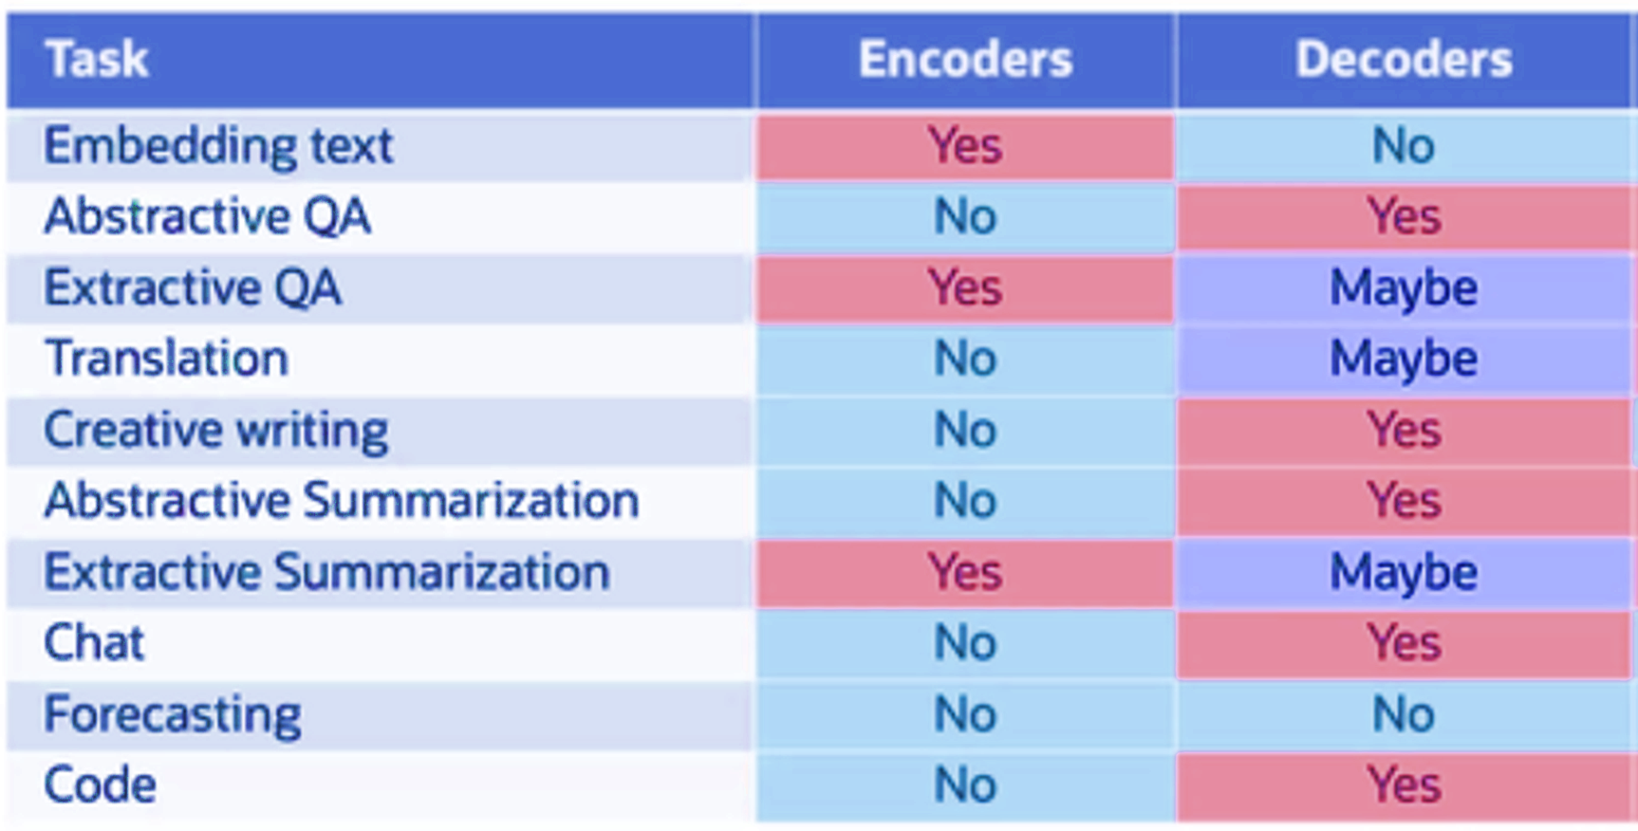

Slide 23
Here are a few risks:
Bias and Fairness: These systems may unintentionally learn and repeat biases from the data they are trained on, leading to unfair results that reinforce existing stereotypes, particularly on topics like gender, race, or other sensitive issues.
False Information: They can confidently produce incorrect or misleading information, contributing to the spread of fake news, deep fakes, and misinformation.
Ethical Use: There are concerns that these systems could be misused for harmful activities, like cyberattacks or creating convincing but fake emails for scams.
Lack of Transparency: It’s hard to understand how these systems make decisions, which can be a problem in important areas like healthcare or finance.
Privacy Concerns: If not managed properly, these models could accidentally remember and reveal private or sensitive information from the data they are trained on.
Environmental Impact: Training these systems requires a lot of computing power, which leads to a significant carbon footprint and environmental concerns.
Security Issues: These models can be vulnerable to attacks, where someone manipulates the input data to make the system give wrong or unintended results.
Social Manipulation: Because these systems can create text that sounds very human-like, there are concerns about their potential use in manipulating social behavior, such as creating fake reviews or social media posts.
Regulatory Challenges: The rapid growth of these systems has outpaced the development of rules and regulations, making it difficult to ensure their responsible use.
To reduce these risks, continuous research, ethical thinking, and collaboration across industries are needed. The aim is to create guidelines and best practices to ensure that these systems are used responsibly and contribute positively without causing harm. As the technology evolves, proactive measures and ethical frameworks will be crucial in shaping a positive future for these systems.

Slide 24
